Slide 1






E-COMMERCE ANALYSIS
Student Details
Name: Subhashini E G
NM ID: aut513321105702
College Name: University College of Engineering - Arni

Slide 2
E-Commerce Analysis
Disclaimer
The content is curated from online/offline resources and used for educational purpose only

Slide 3

Course Outline
E-Commerce Analysis
Abstract
Problem Statement
Aims, Objective & Proposed System/Solution
System Deployment Approach
Model Development & Algorithm
Future Scope
Video of the Project
Conclusion
Reference

Slide 4


E-Commerce Analysis
Abstract
The Project Provides an analysis of sales data from an e-commerce dataset to understand key sales trends and patterns for the year 2019. The data consists of various attributes such as order ID, quantity ordered, price, order date, purchase address, product, and others. The analysis includes data preprocessing and cleaning to ensure accurate and relevant insights. The analysis utilizes visualizations such as bar charts and line graphs to present data in an accessible manner. This helps to identify trends and patterns that can guide decision-making for sales strategies, marketing campaigns, and inventory management. Overall, the project offers valuable insights into the e-commerce sales data for 2019 and provides potential opportunities for business improvement.

Slide 5


E-Commerce Analysis
Problem Statement
Conduct an exploratory data analysis to gain insights into sales performance, sales trends
Customer purchasing patterns across different cities, products, and time periods.

Slide 6

E-Commerce Analysis
Aim and Objective
Aim: The primary objective of this Final Seminar is to present the outcomes and advancements made in the project “E-Commerce Analysis”.

Slide 7
E-Commerce Analysis
Objectives
1. Data Acquisition and ingestion :
Gather data from diverse sources such as online store transactions, sales records , and other relevant datasets.
Automate the data ingestion process using cloud-based data pipelines.
2. Data Cleaning and Processing:
Clean and preprocess the raw data by handling missing values, correcting data types, and removind duplicates.
Transform data into a suitable format for analysis and model training.
3. Exploratory Data Analysis(EDA):
Perform exploratory data analysis to identify trends, patterns, and insights within the data.
Create visualizations such as charts and graphs to communicate findings to stakeholders.

Slide 8

E-Commerce Analysis
Proposed Solution
Load the CSV files from the specified folder and combine them into a single DataFrame.
Clean the data by excluding rows with headers and missing values.
Extract features such as year, month, hour, and city from the data.
Analyze the data with histograms, boxplots, and bar charts.
Examine sales patterns across different time periods and cities.
Calculate monthly and yearly probabilities for specific products.
Notes:
8

Slide 9
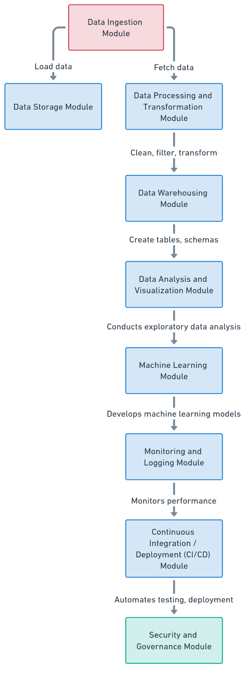
E-Commerce Analysis
System Deployment Approach
Notes:
9

Slide 10
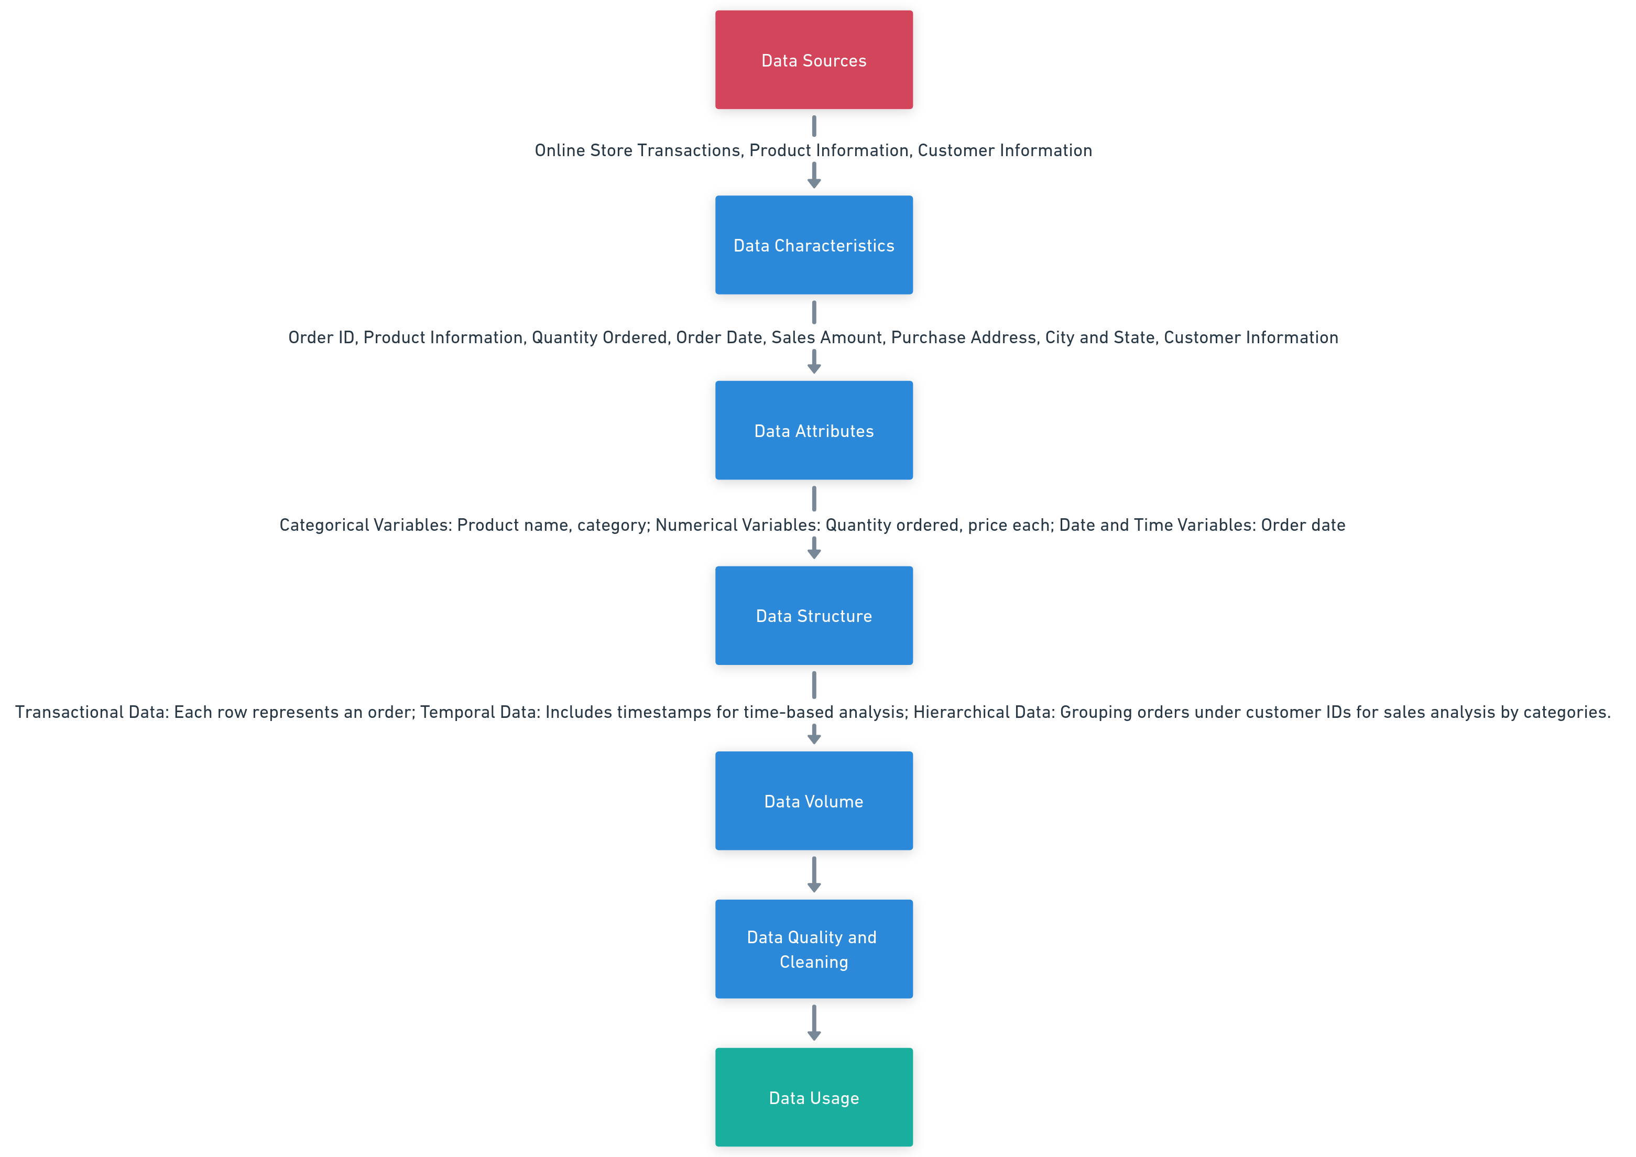
E-Commerce Analysis
Model Development & Algorithm
Dataset Description:
Notes:
10

Slide 11
E-Commerce Analysis
Model Development & Algorithm
Model Training and validation:
Train the selected model on the training data and optimize hyperparameters.
Validate model performance using cross-validation and other techniques.
Model Evaluation:
Evaluate model performance using appropriate metrics(e.g., accuracy, precision, recall, RMSE).
Compare model results to select the best-performing model.
Model Deployment and Prediction:
Deploy the trained model for real-time predictions and make the model available as a service.
Use the model to predict outcomes based on new input data.
Notes:
11

Slide 12
E-Commerce Analysis
Model Development & Algorithm
Regression problems: Algorithms such as linear regression, random forest regressor , and gradient boosting machines (GBM) are suitable for predicting continuous outcomes like sales forecast.
Classifications problems: Logistic regression, decision trees, random forest classifier, support vector machines(SVM), and neural networks are effective for binary and multi-class classification tasks.
Recommendation Systems: Algorithms such as collabrative filtering, content-based filtering, and matrix factorization help provide personalized product recommendations based on user-item interactions and preferences.
Notes:
12

Slide 13
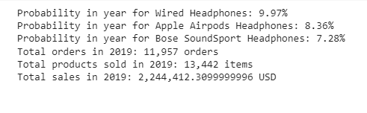
E-Commerce Analysis
Result
Notes:
13

Slide 14

E-Commerce Analysis
Future Scope
The scope of the project can be defined in terms of the extent of data analysis, potential use cases, and avenues for further exploration and application. The project cover the following areas:
Data Coverage: The project focuses on sales data from an e-commerce dataset for the year 2019. The analysis includes order data, such as order ID, quantity ordered, price each, order date, purchase address, product details, and more.
Time Frame: The analysis is limited to the year 2019, but the methods and techniques can be applied to data from other years for longitudinal analysis.
Notes:
14

Slide 15
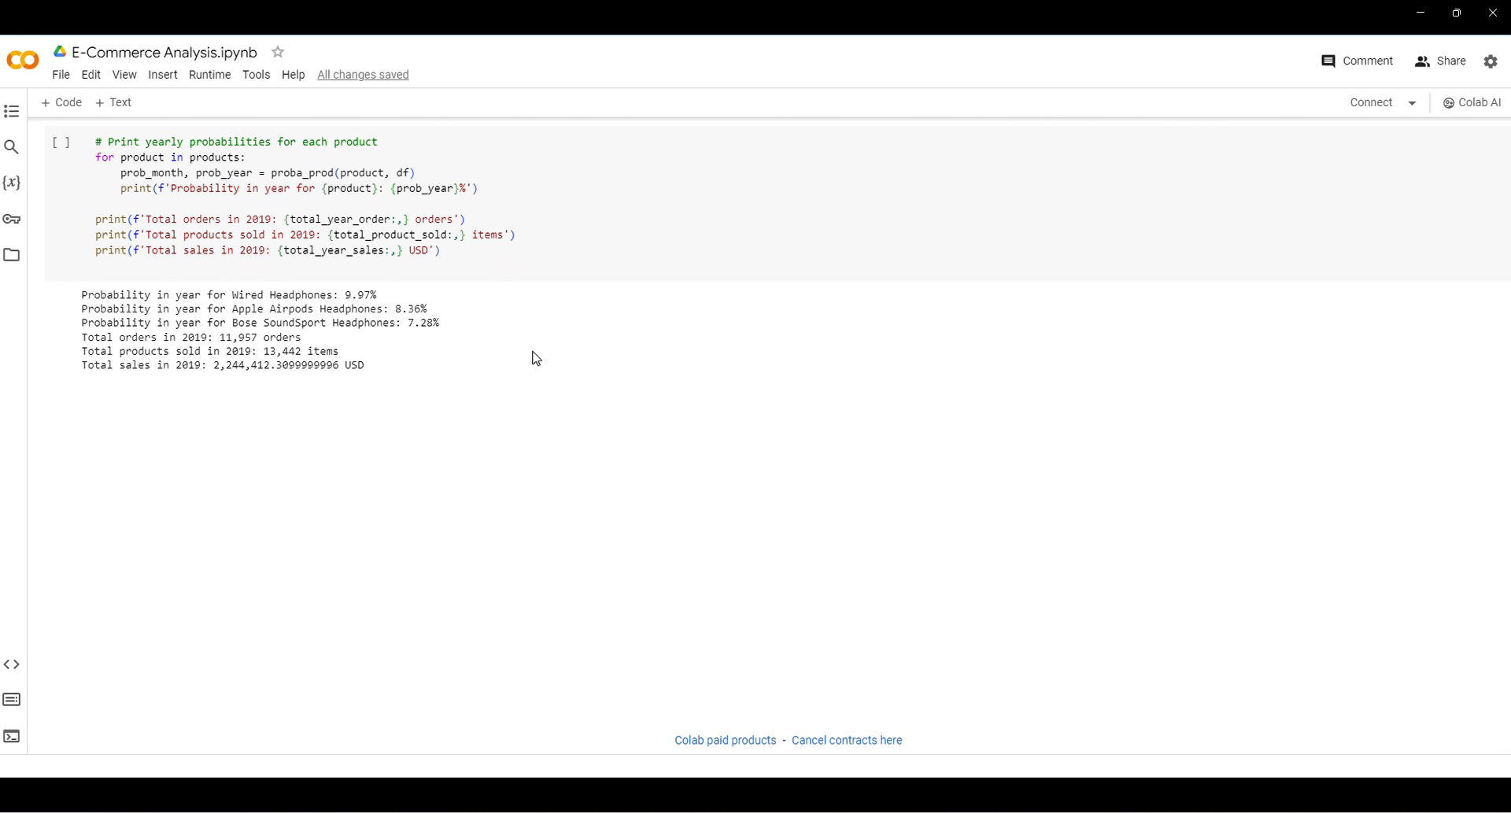
E-Commerce Analysis
Video of the Project
Notes:
15

Slide 16

E-Commerce Analysis
Conclusion
In conclusion, the e-commerce sales data analysis project using cloud computing leverages advanced data processing and machine learning techniques to provide valuable insights and enable data-driven decision-making. The project involves analysis sales data, conducting exploratory data analysis(EDA), and using machine learning models for sales forecasting, product recommendations, and customer behavior prediction
Notes:
16

Slide 17
E-Commerce Analysis
Reference
Notes:
Reference
These are the references for this session.

Slide 18
E-Commerce Analysis
Thank you!
Notes:
18

